Slide 1
Prediction of Seizures During Sleep
Group 17: Nikhil Patel, Jack Lin, Josh Olick-Gibson

Slide 2
For 1 in 3 people with epilepsy, there is currently no available treatment that controls their seizures.
Statistics from Healthline [2]
Notes:
65 million people around the world have epilepsy
In the US, 1 in 26 people will develop epilepsy at some point
Symptoms can range from a minor space out (absence seizure) to severe convulsions (tonic-clonic seizure)
Type of seizures are classified by where they begin in the brain
Generalized → begin in both sides of the brain
Focal onset → begin in one side of the brain
Types of treatment
Medication
Devices (implantable?)
Surgery
Dietary therapy
These treatments are not effective for 1 in 3 people (intractable epilepsy)

Slide 3
Sudden Unexpected Death in Epilepsy (SUDEP) is believed to be the leading cause of epilepsy related deaths.
Image from SUDEP Action [3]
Notes:
SUDEP is the cause of death in an epileptic person when no other cause of death is found
Most cases are not diagnosed without an autopsy
No specific cause is known, but several risk factors have been identified
People who experience generalized tonic-clonic seizures
Abrupt changes in medication
Excessive drinking
Use of illicit drugs
Having epilepsy for more than 15 years
Having seizures during sleep
Experts have concluded that incidence of SUDEP can be reduced using early detection methods and patient monitoring during a seizure

Slide 4
Clinical Need
There is a need to alert individuals who are at high risk for seizure during sleep to an impending epileptic event to decrease the frequency of Sudden Unexpected Death in Epilepsy (SUDEP).

Slide 5
Project Scope
This project proposes to deliver a safe, comfortable, and easy to use device that can be worn overnight. It will use available physiological data to accurately predict an impending seizure, and will alert the user and emergency medical services a short time (on the order of minutes) before the seizure begins.
Notes:
*We say that this will alert the user and emergency medical services both before the seizure begins, but say in the specs that we will alert EMS after the seizure has been detected

Slide 6
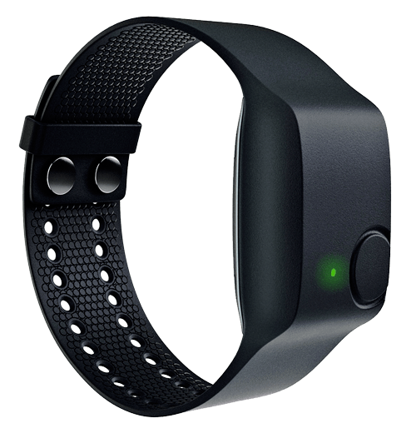
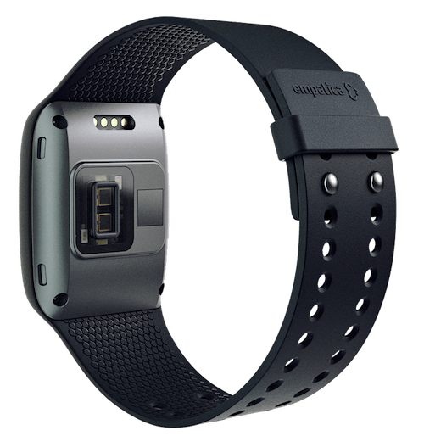
Most seizure detection devices on the market rely on accelerometry.
Front and rear view of the Empatica E3 wristband [4]
Notes:
Wristbands/watches
Some also use pulse/electrodermal activity
Cell phones (apps)
Mattress sensors
Empatica
Accelerometer, Gyroscope, Electrodermal activity sensor, Peripheral temperature sensor
Uses bluetooth connection to a phone to alert preprogrammed caregivers so the patient can get the care they need
Problems:
Many activities that can appear to simulate a seizure (high false positive rate or inability to detect during that time)
Assumed that these are not being worn during sleep (need to charge/not comfortable)
Can only detect, cannot predict

Slide 7
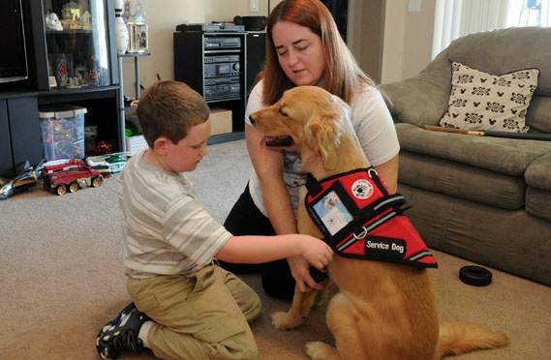
Other commonly used methods of detection include video/audio classification and seizure-alert dogs.
Victory, a trained Golden Retriever with her owners Andrew and Michelle [5]
Notes:
Problems
Video/Audio classification
Can only detect seizures with a high degree of active motion/sound
Can only be done when audio/video monitoring are occurring
Dogs
Can only detect when they are awake and alert (presumably not during sleep)
Require a dog to be around (cannot always happen)
Often golden retrievers

Slide 8
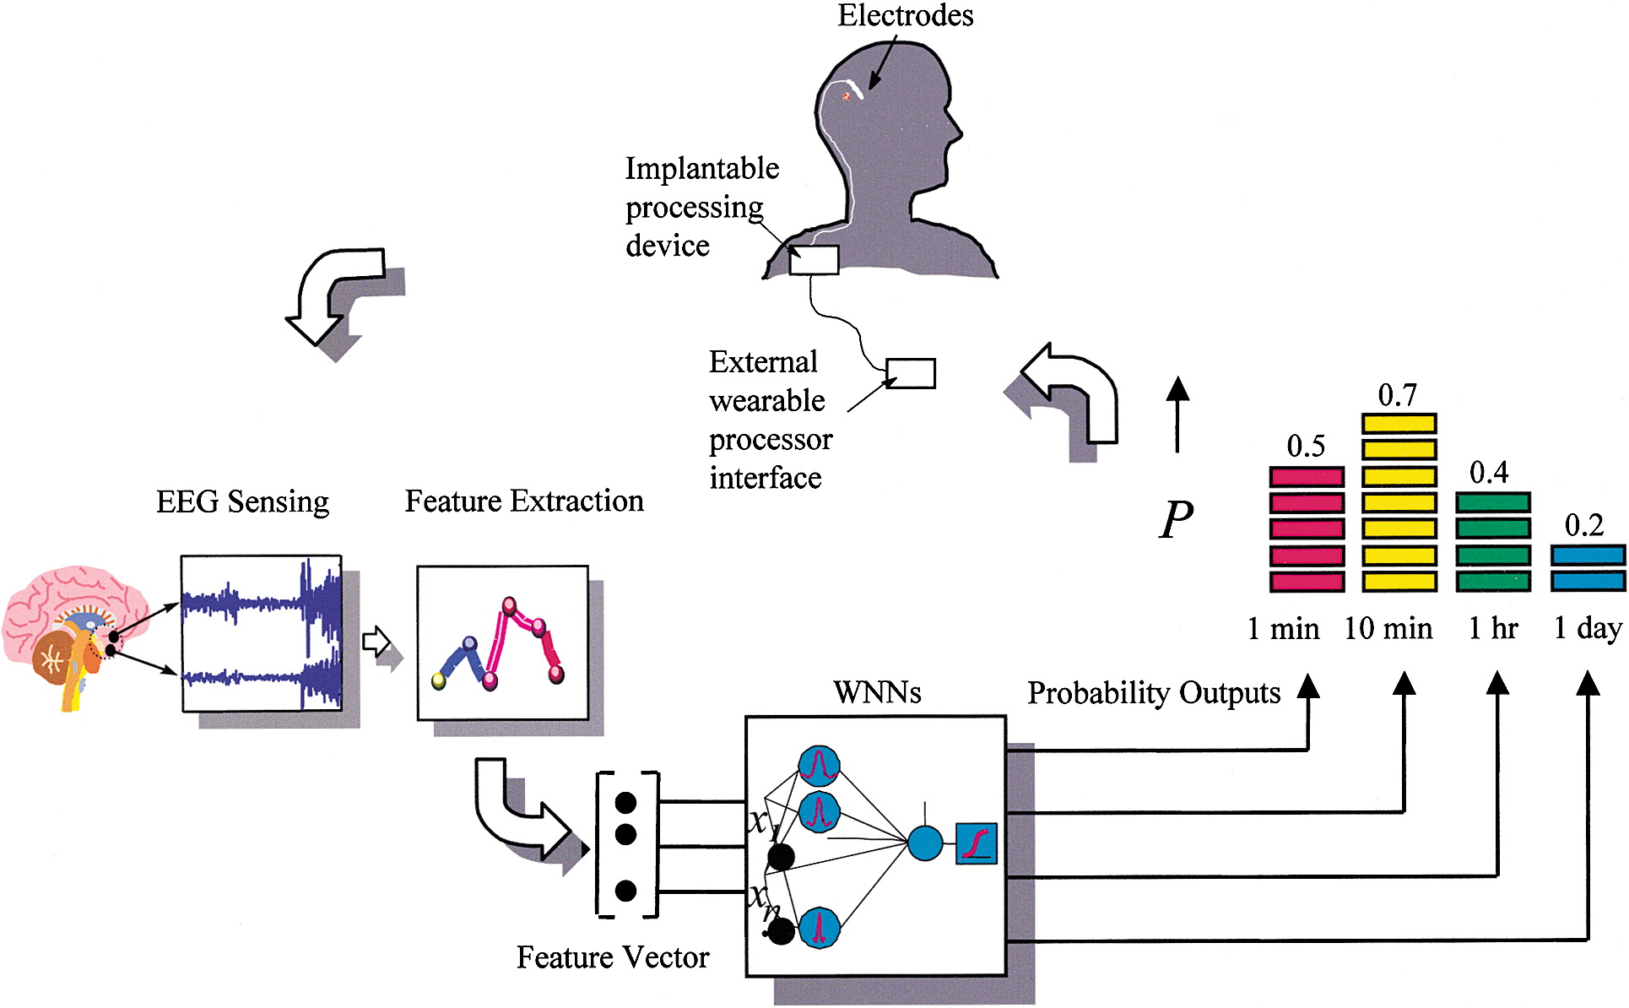
Machine learning algorithms are commonly used for seizure prediction and detection.
Overview of a theoretical ECoG machine learning prediction algorithm as outlined by Litt et al. [6]
Notes:
Collect data from the patient (EEG, ECoG, or other signal)
Preprocessing
Used to transform data into a more usable for or to remove data that is not valuable in the analysis
Feature extraction
Principal Component Analysis
Fourier analysis
Wavelet transformation → Similar to fourier analysis, but involves analysis both in frequency and in time
Feature reduction
Feature selection (choose the most meaningful subset of computer features)
Feature extraction (Compress the information into fewer features)
Commonly used features
Mean
Correlation dimension
Power, etc.
Train classifier (using a portion of the data)
SVM (support vector machine) → divide data as much as possible using optimal hyperplane
ANN (Wavelet Neural Network) → pass input through a series of “neurons” that each process one feature of the data and pass it to the next “neuron”
k-NN (K-nearest neighbors) → Find k sets of the nearest matching data and classify based on those labels
Prediction using remainder of the data
Once the probability crosses some threshold → classify as a seizure/impending seizure

Slide 9
Most research in seizure prediction and detection relies on EEG and ECoG signals.
Normalized feature (mean of the mean of the curve length for bipolar signal LTA1–LTA2) and classifier outputs for training data for the final feature selected for patient E [7]
Notes:
Cause of a seizure is sudden and disorganized electrical activity in the brain → EEG/ECoG is an effective method of determining if an individual is having/about to have a seizure
Patient E EEG data over 11 seizures (2 training, 9 validation)
4 hours of baseline data
Feature selection from over 25,000 possible features
Narrowed down to 800 (curve length, energy, nonlinear energy)
Selected the best using a “genetic algorithm”
Randomly select a set of “chromosomes (channel, and 1st, 2nd, and 3rd level features) and use them to classify the data then have them be the starting point for guessing the next set to improve the classification
Feature chosen was mean of the mean of the curve length for channel LA1-LA2 (contralateral to the focus)
100% prediction accuracy with average prediction time of 2.1 minutes and 1.1 FPH
Reason could be limited number of electrodes, limited number of seizures/amount of baseline data
Require EEG or ECoG Signal
-Difficult to capture from home
-Would require sleeping with scalp electrodes
-Poor resolution
-Can’t be worn for long periods of time
-ECoG requires an invasive procedure
Typical EEG Costs $200-$700
Can cost up to $3000 for 24 hour EEG with video recording
Cost of intracranial EEG - Unknown

Slide 10
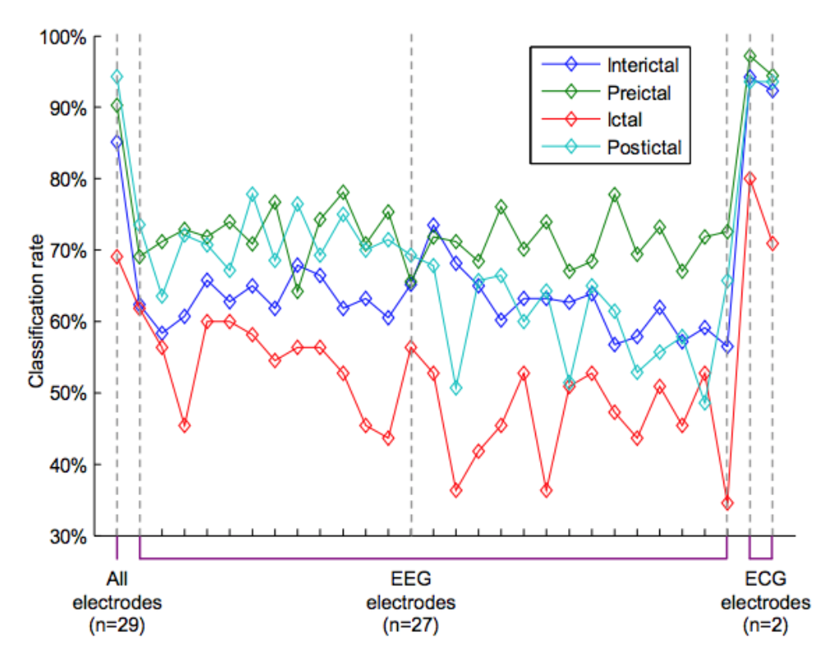
Non-EEG signals can be used to predict seizure.
Classification rates for patient 1 using the features from all electrodes combined (left) and the features from each individual electrode [8]
Notes:
Study by Valderrama et al. showed that the use of ECG electrodes improves classification accuracy
This is data for one patient over 7 days of recording. The classification accuracy for each of 27 individual EEG electrodes and for 2 ECG electrodes are shown
A support vector machine learning algorithm was used to classify the seizures
The accuracy is seen to be highest for both all electrodes and the ECG electrodes.
(One of the reasons explaining the higher rates for the ECG electrodes can be the fact that the features chosen for ECG analysis were more stables along the recordings than EEG ones)
ECG data used were heart rate variability and heart rate
For the entire study (4 patients totalling 29 seizures) the sensitivity was 90.6% and the specificity was 85.6% using a 10 minute long window of pre-ictal recording

Slide 11
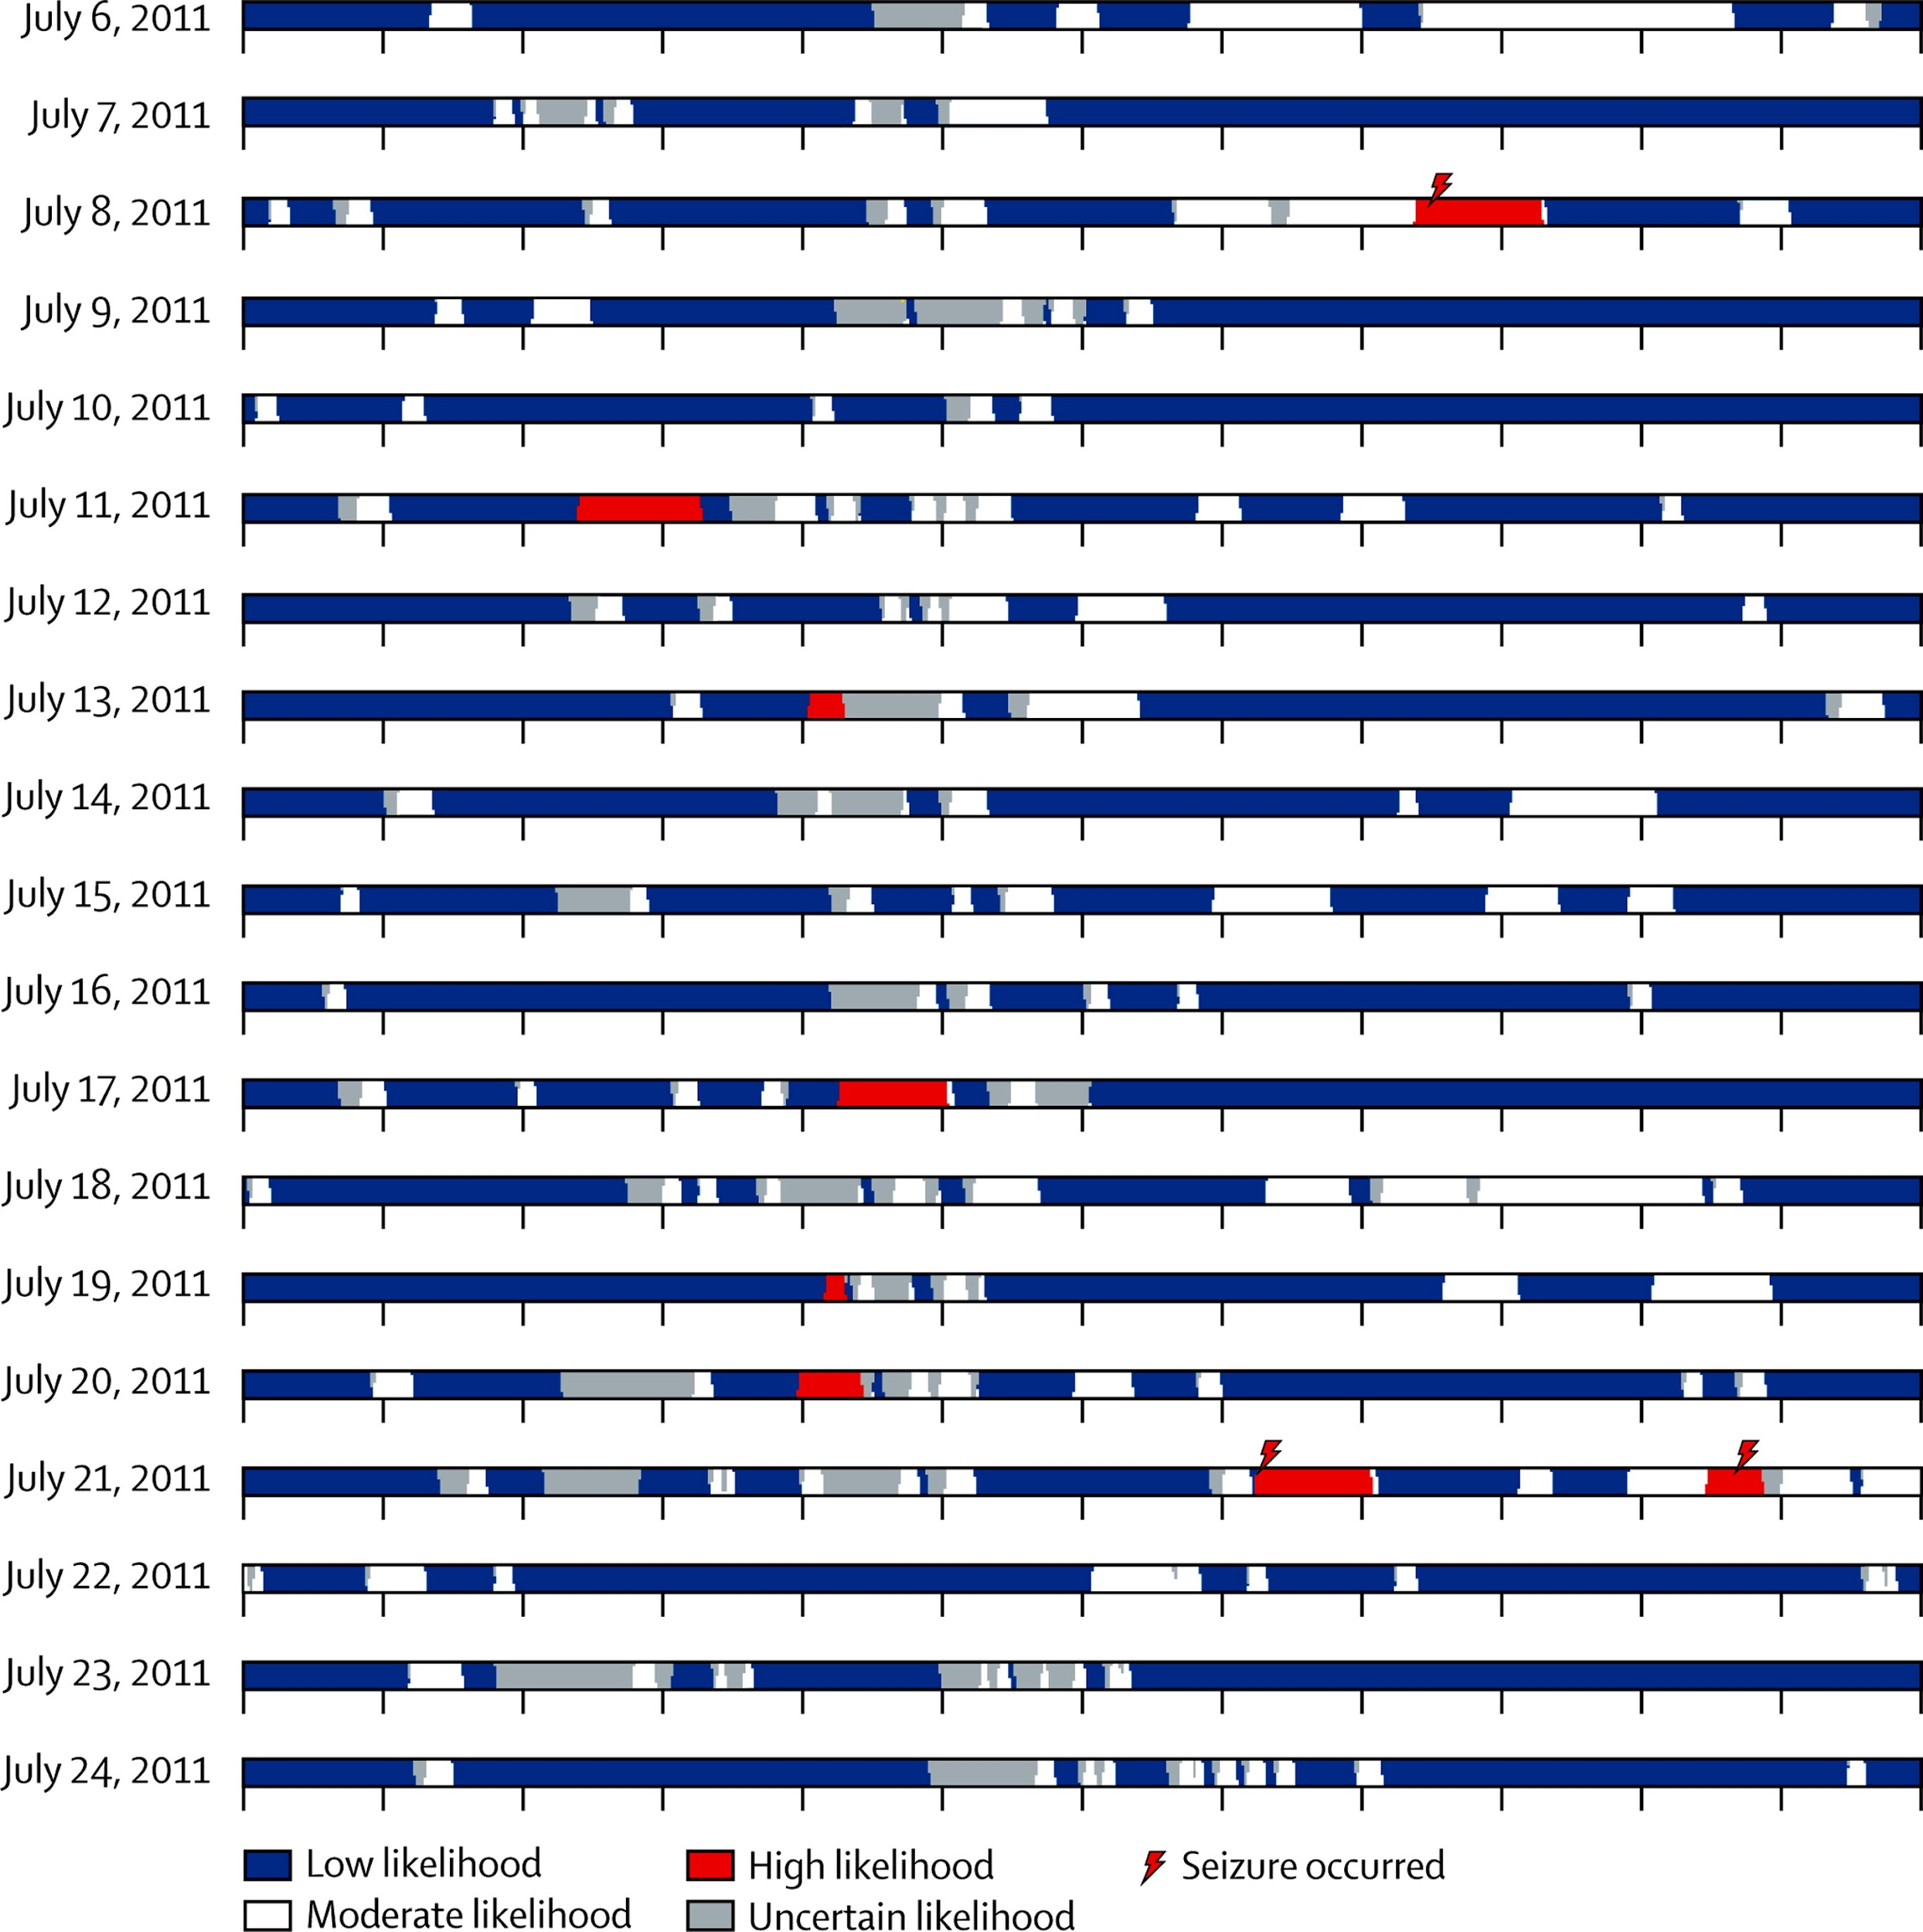
Real-time seizure prediction can be achieved with high sensitivity.
Excerpt from Patient 2’s advisory timeline [9]
Notes:
Cook et al. performed a study in which 15 patients were implanted with an iEEG system
They underwent a 1 month data collection period containing at least 5 seizure per patient
This data was annotated with seizure/non-seizure
Then an algorithm was developed (unique for each patient) based on EEG data (using the same type of machine learning algorithms as discussed before)
Patients then underwent a three month real-time advisory period during which an advisory indicator would show blue, white, and red lights indicating low, moderate, and high likelihood respectively (in addition to audio/vibration indicators)
Overall sensitivity of 65-100% for every patient

Slide 12
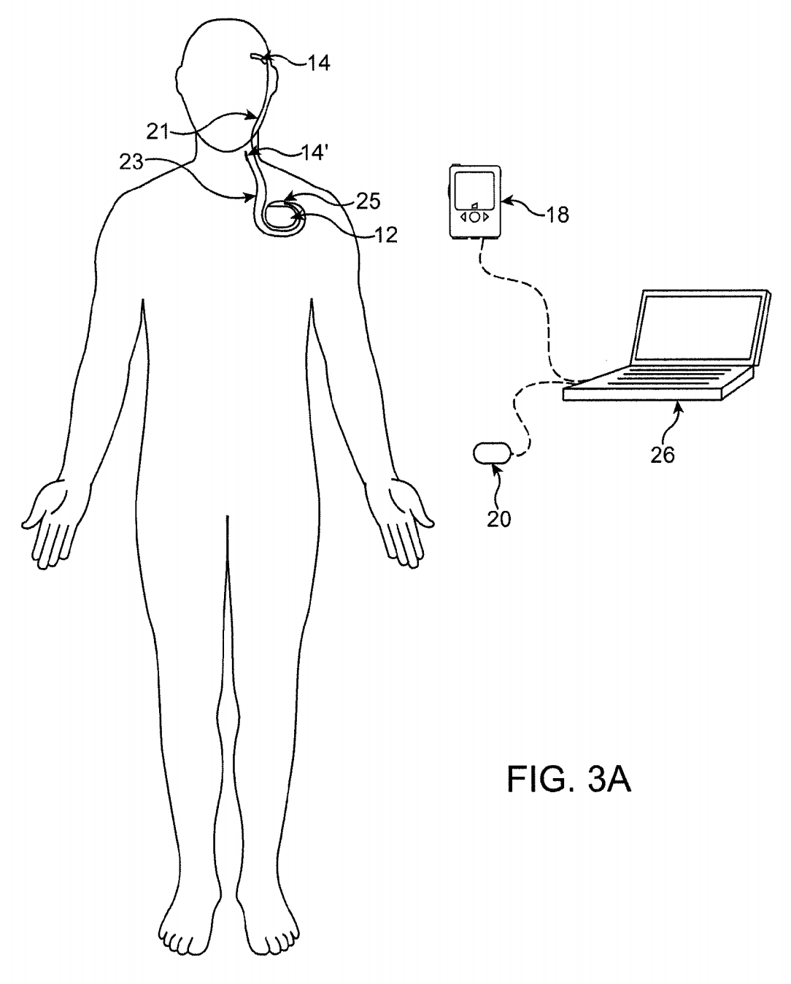
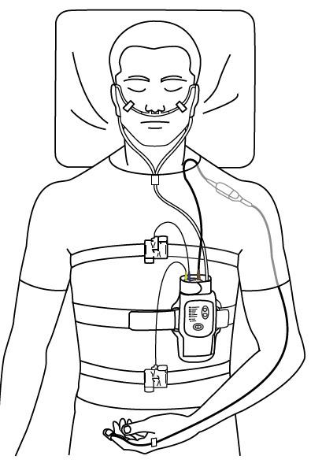
Patents and Related Technology
Figure from patent by Leyde and Dilorenzo [10]
Typical setup for a home sleep apnea test [11]
Notes:
Number of patents that exist that describe similar technology
-Layde /Dilorenzo outline a method of determining a patient’s neurological state using EEG data and a machine learning algorithm
-This patent is meant for the potential to recommend emergency drug dosages depending on potential for a seizure
-Many others for devices like mattress sensors and wristwatches
Significant overlap with technology for sleep apnea/Sudden infant death
-Many of these devices use sensors for things like Oxygen saturation, respiration, heart rate, etc.
-Some of these require manual scoring of results by a physician and other have an automatic scoring function to determine whether a patient experiences sleep apnea
-Similar devices are also used to detect sudden infant death such as one that uses video monitoring and pulse oximetry → will alert the parents if the child appears to be at risk for SID

Slide 13
Design Specifications: Sensor
Specification | Unit | Value | Description
Safety | Unitless | Unitless | Device should be safe to wear during sleep. It should not contain sharp edges or cords that can tangle, and should be properly insulated
Comfort | Unitless | Unitless | Device should not prevent the user from sleeping comfortably
Size | cm | cm | Device size should not hinder the patient’s ability to sleep and should be large enough to be able to collect the relevant data
Weight | g | g | Device weight should not hinder the patient’s ability to sleep
Operating time | Hours | 12 Hours | Device should be operational throughout the night

Slide 14
Design Specifications: Sensor
Specification | Unit | Value | Description
Consumer Cost | $ | $1,000 | Device consumer cost is predicted by client to be of similar cost to current AED devices
Production Cost | $ | $300 | Device production cost is estimated to be ⅓ of the consumer cost
Transmission | unitless | unitless | Device should transmit signals wirelessly to the receiver
Software Platform | unitless | unitless | Device should be able to collect the necessary data and send them to the receiver

Slide 15
Design Specifications: Receiver
Specification | Unit | Value | Description
Software platform | Unitless | Unitless | Device software should process data with minimal delay, predict an impending seizure, and send an alert to the patient and EMS
Prediction Interval | Min | 5-60 min | Device should be able to alert the patient of impending seizure 5 to 60 min prior to onset
Prediction Alert | Unitless | Unitless | Device should acoustically alert the patient when an impending seizure is predicted
Detection Alert | Unitless | Unitless | Device should alert emergency services when an active seizure is detected

Slide 16
Design Specifications: Receiver
Specification | Unit | Value | Description
Reliability (Repeatability) | Unitless | 0.9 | Consistency in measurements taken by the device across multiple trials
Sensitivity | % | 90% | Device should accurately predict an impending seizure within a certain percentage
Range | m | 20 m | Device should be able to receive signals from the sensor within 20 meters
Security | % | 100% | Data collected will only be accessible to the user and to emergency services

Slide 17
Preliminary Design Schedule

Slide 18
Team Responsibilities
Responsibility | Jack Lin | Josh Olick-Gibson | Nikhil Patel
Written Reports | x | x | x
Weekly Reports | x | x | x
Website | x
Software Development |  |  | x
Hardware Development | x | x
Preliminary Presentation |  |  | x
Progress Presentation | x
V&V Presentation |  | x
Poster | x | x | x
Final Presentation | x | x | x

Slide 19
Sources
1. Shafer, P. epilepsy.com. Epilepsy Foundation (2014). Available at: https://www.epilepsy.com.
2. Holland, K. & Krucik, G. Epilepsy by the Numbers: Facts, Statistics, and You. Healthline (2014).
3. Tomson, T. sudep.org. SUDEP Action Available at: http://sudep.org.
4. Empatica Inc. Empatica. (2017). Available at: www.empatica.com.
5. Hammett, Y. Seffner community helps boy buy seizure-detecting dog. Tampa Bay Online (2013).
6. Litt, B. et al. Epileptic seizures may begin hours in advance of clinical onset: A report of five patients. Neuron 30, 51–64 (2001).
7. D’Alessandro, M. et al. A multi-feature and multi-channel univariate selection process for seizure prediction. Clin. Neurophysiol. 116, 506–516 (2005).
8. Valderrama, M., Nikolopoulos, S., Adam, C., Navarro, V. & Le Van Quyen, M. Patient-specific seizure prediction using a multi-feature and multi-modal EEG-ECG classification. in IFMBE Proceedings 29, 77–80 (2010).
9. Cook, M. J. et al. Prediction of seizure likelihood with a long-term, implanted seizure advisory system in patients with drug-resistant epilepsy: A first-in-man study. Lancet Neurol. 12, 563–571 (2013).
10. Leyde, K. & Dilorenzo, D. Methods and Systems for Recommending an Appropriate Action to a Patient for Managing Epilepsy and Other Neurological Disorders. (2007).
11. Smith, W. No Title. Medscape (2015).

Slide 20
Questions?

